Slide 1


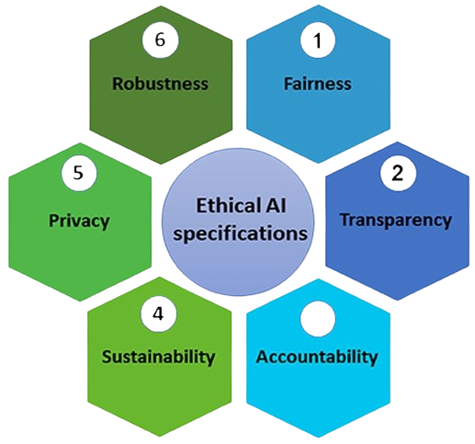
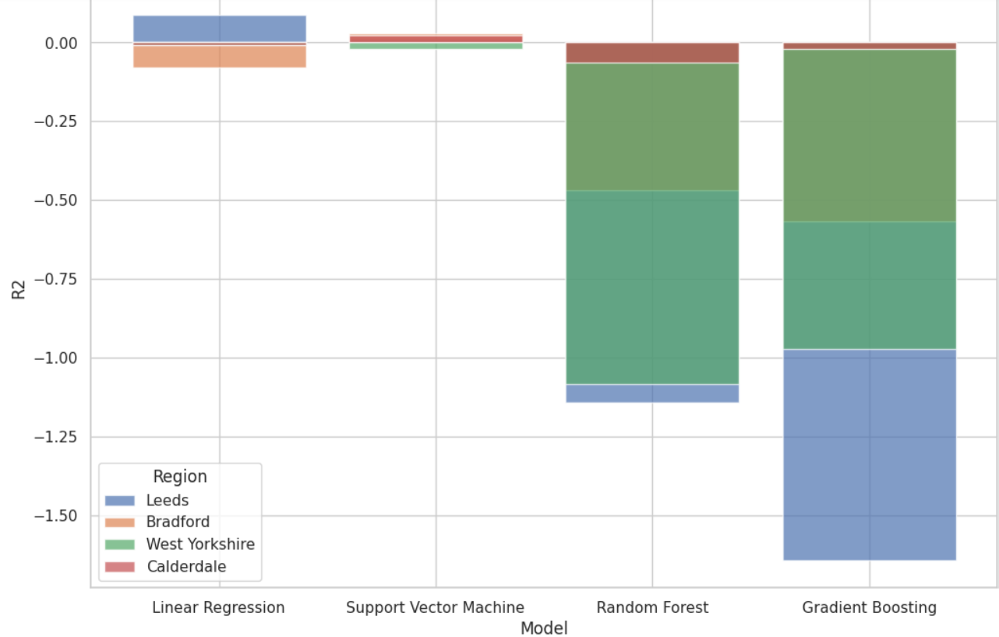


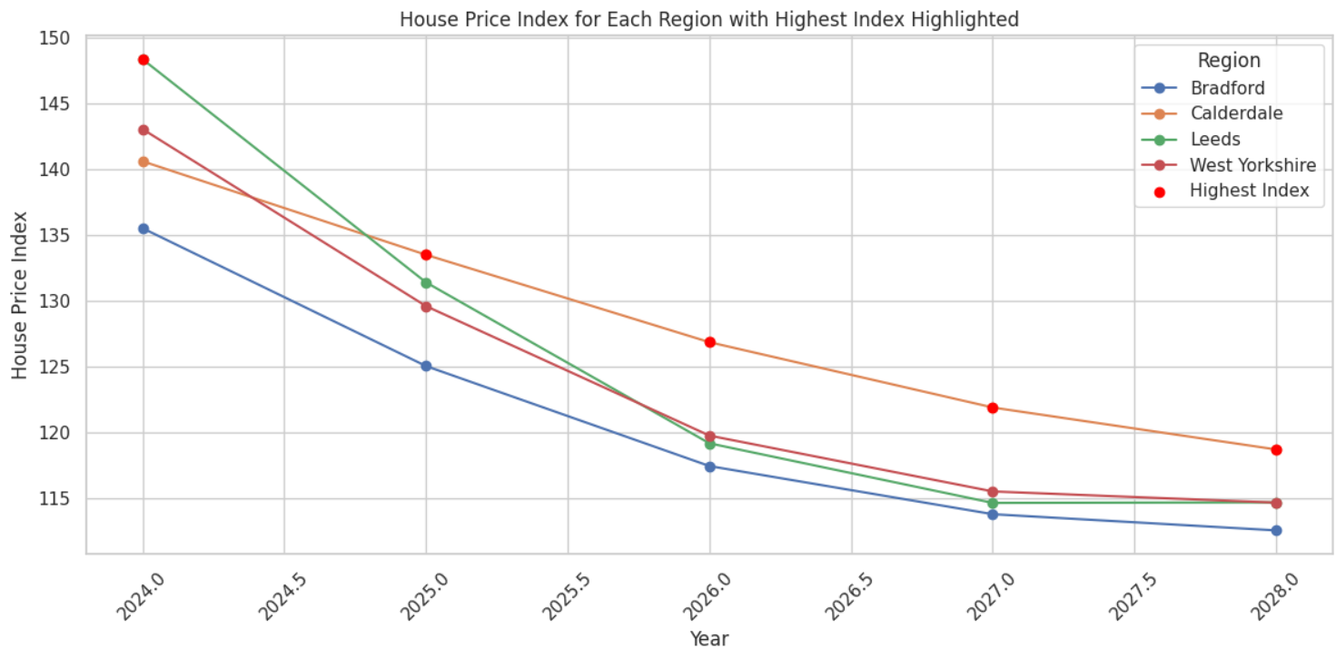

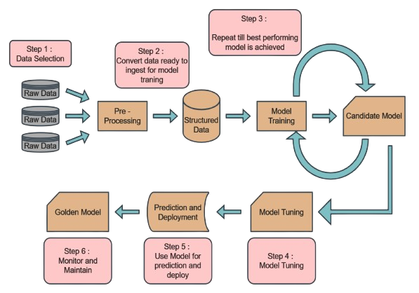

Machine learning improves predictions of UK house prices, assisting buyers and investors in making wiser choices. It also has to deal with issues like data security and quality, which emphasizes the necessity of preparing data. Neural networks, SVM, Random Forest, Gradient Boosting, and Linear Regression are among the often employed methods.
House Price Prediction in UK using Machine Learning
Name: Jaydeep Gohel(77353725)
SCHOOL OF BUILT ENVIRONMENT, ENGINEERING AND COMPUTING
MSc Data Science
Supervisor: Hadeel Jazza
OVERVIEW
LITERATURE REVIEW
ETHICAL CONSIDERATIONS
Machine learning can improve house price forecasts, which has a significant impact on the real estate industry. Large-scale data analysis is done by ML, as opposed to traditional approaches, to identify complex trends that improve projections. Big data and quick computation enable machine learning (ML) to detect long-term issues and adjust to changes in the market. The purpose of this study is to investigate potential dangers and opportunities associated with using machine learning (ML) in the housing market.
Machine learning improves predictions of UK house prices, assisting buyers and investors in making wiser choices. It also has to deal with issues like data security and quality, which emphasizes the necessity of preparing data. Neural networks, SVM, Random Forest, Gradient Boosting, and Linear Regression are among the often employed methods.
impact of machine learning on UK home price prediction, highlighting its potential for higher accuracy compared to conventional techniques. It draws attention to issues including data privacy, data quality, and the requirement for sophisticated models. Important subjects include popular prediction methods, data preparation, and research gaps, with an emphasis on increasing forecasting accuracy.
RESEARCH OUTCOME AND DISCUSSION
Model analysis
AIM AND OBJECTIVES
Perdition
ACKNOWLEDGEMENTS
The goal of this project is to reliably forecast UK home values using machine-learning algorithms, enabling knowledgeable real estate market decision-making.
Objectives:
1. Collect and evaluate information about houses, including location, economic factors, historical values, and property details, for the housing industry.
2. Create and implement machine learning algorithms for predicting house values, such as neural networks, clustering, and regression models.
3. Evaluate and contrast scenario performance with industry standards and baseline models.
4. Examine how diversity affects UK housing market growth predictions and factors that influence house prices.
5. Take into account data on machine learning techniques and resources for forecasting house values and other aspects of the UK housing industry.
I would like to express my sincere gratitude to my supervisor, Prof. Hadeel Jazza, for her invaluable assistance, support and encouragement to shape this project.
METHODOLOGY
Pre-Processing: clean data, remove null values, data balancing
Structure data: Feature Engineering,
Model: Guardian Boost classifire, Linear regression, SVM, Random Forest
In 2024, Leeds will have the highest index of home prices.
2. From 2025 to 2028, Calderdale will top the home price index.
3. The rising score for Calderdale indicates rising demand or attraction.
CONCLUSION
REFERENCES
The dissertation concludes that Support Vector Machines (SVM) are the best at predicting UK housing prices, but future research should explore additional factors and advanced methods like GRU or LSTM to improve accuracy and capture market trends.
Drawbacks:
Incomplete data due to privacy regulation.
difficulty of adapting machine learning models to the rapidly changing housing market..
Future work:improve data collection, use adaptive models, integrate economic insights, ensure ethical compliance, and increase transparency

Slide 2
Youtube Link: https://youtu.be/zuthEtCE3hg Github Link: https://github.com/jaydeep232000/jaydeep Dataset Link: https://github.com/jaydeep232000/jaydeep/blob/main/ukhpi-comparison-all-hpi-bradford-from-2013-01-01-to-2029-01-01.csv or https://drive.google.com/file/d/16t1O1krXYarGV1SNmwakwd2RRX_48dza/view?usp=drive_link

